Slide 1
Introduction to AI (Machine Learning)

Slide 2
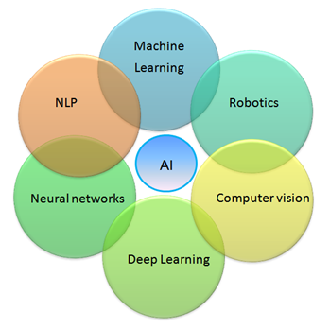
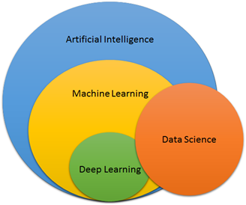
ARTIFICAL INTELLIGENCE & ITS DOMAINS

Slide 3
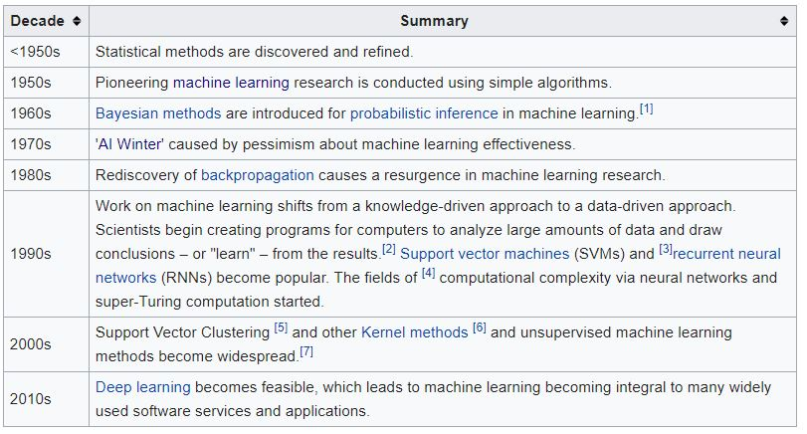
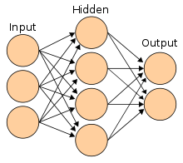

Slide 4
The concept of learning in a ML system
• Learning = Improving with experience at some task
– Improve over task T,
– With respect to performance measure, P
– Based on experience, E

Slide 5
Learning
“Learning denotes changes in a system that ... enable a system to do the same task … more efficiently the next time.” - Herbert Simon
“Learning is constructing or modifying representations of what is being experienced.” - Ryszard Michalski
“Learning is making useful changes in our minds.” - Marvin Minsky
“Machine learning refers to a system capable of the autonomous acquisition and integration of knowledge.”

Slide 6
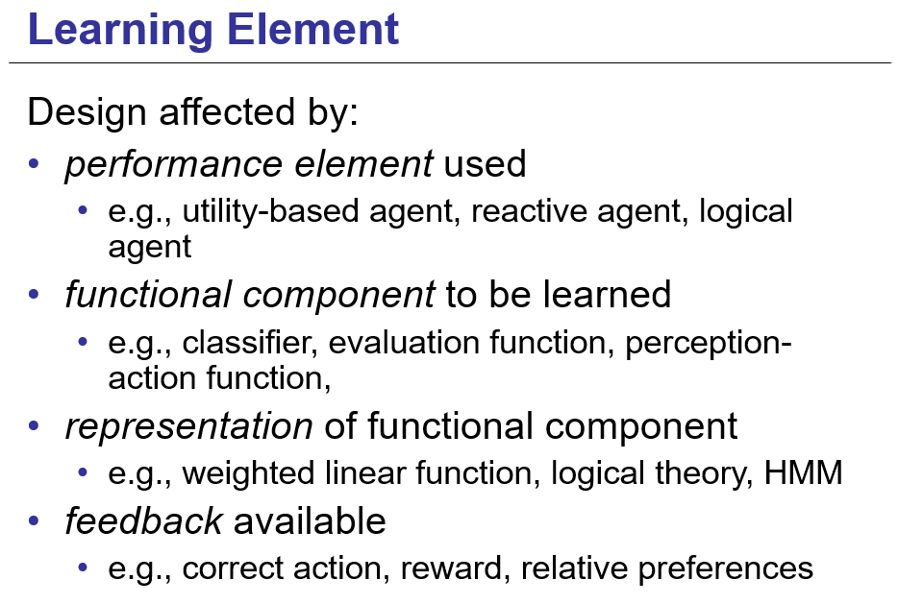

Slide 7
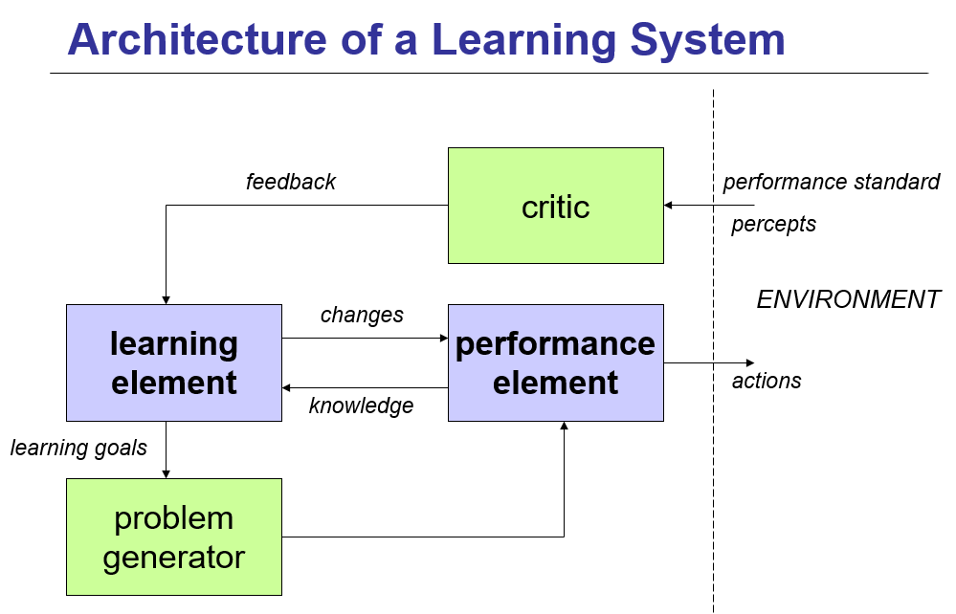

Slide 8
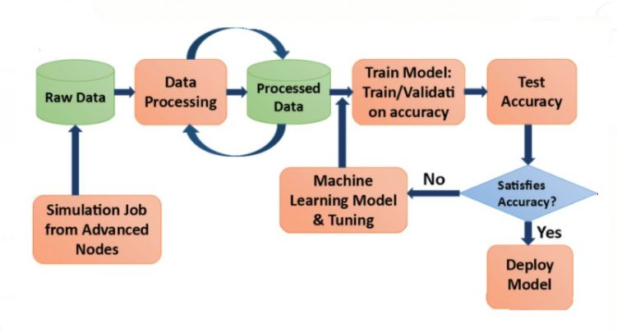

Slide 9
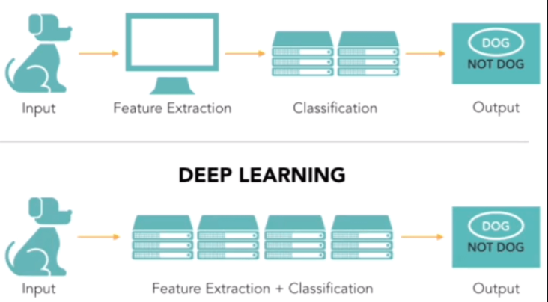
MACHINE LEARNING VS DEEP LEARNING

Slide 10
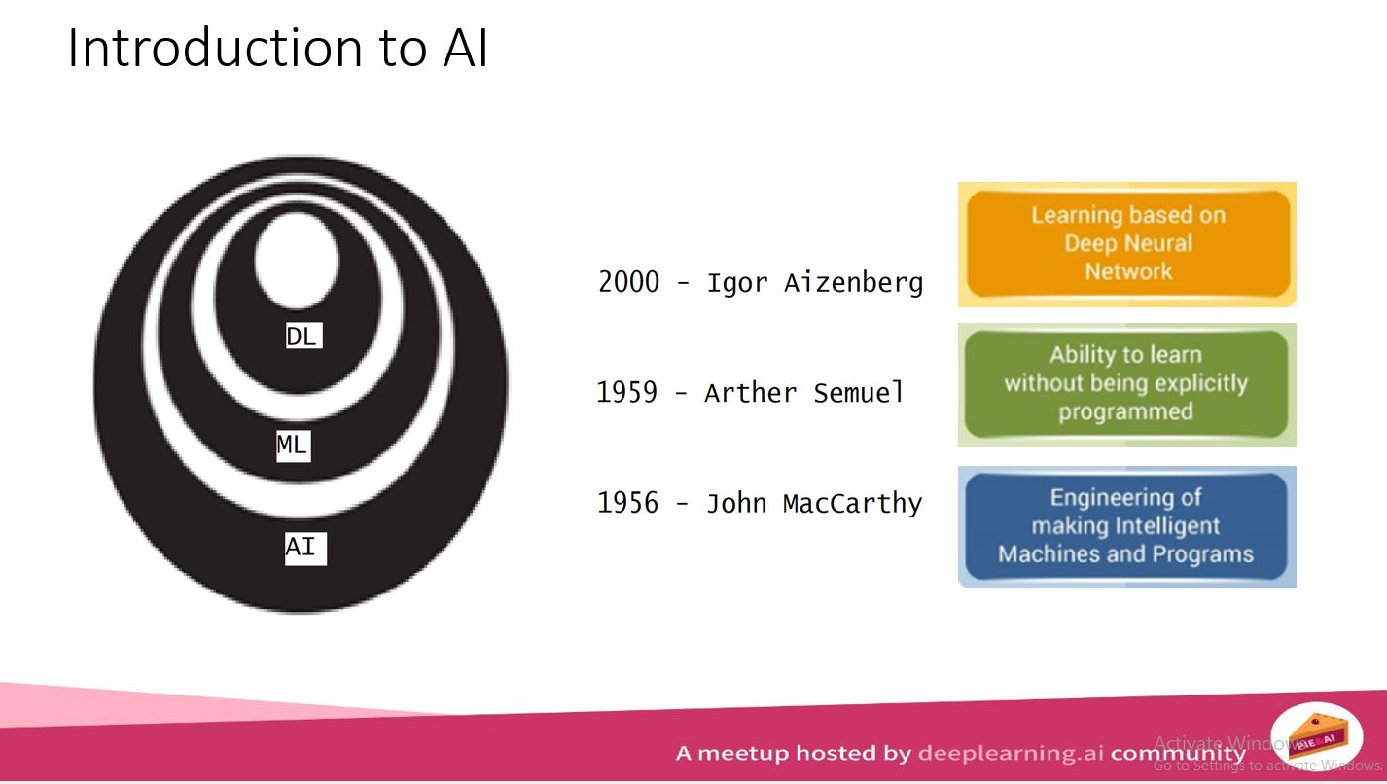
MACHINE LEARNING VS DEEP LEARNING

Slide 11
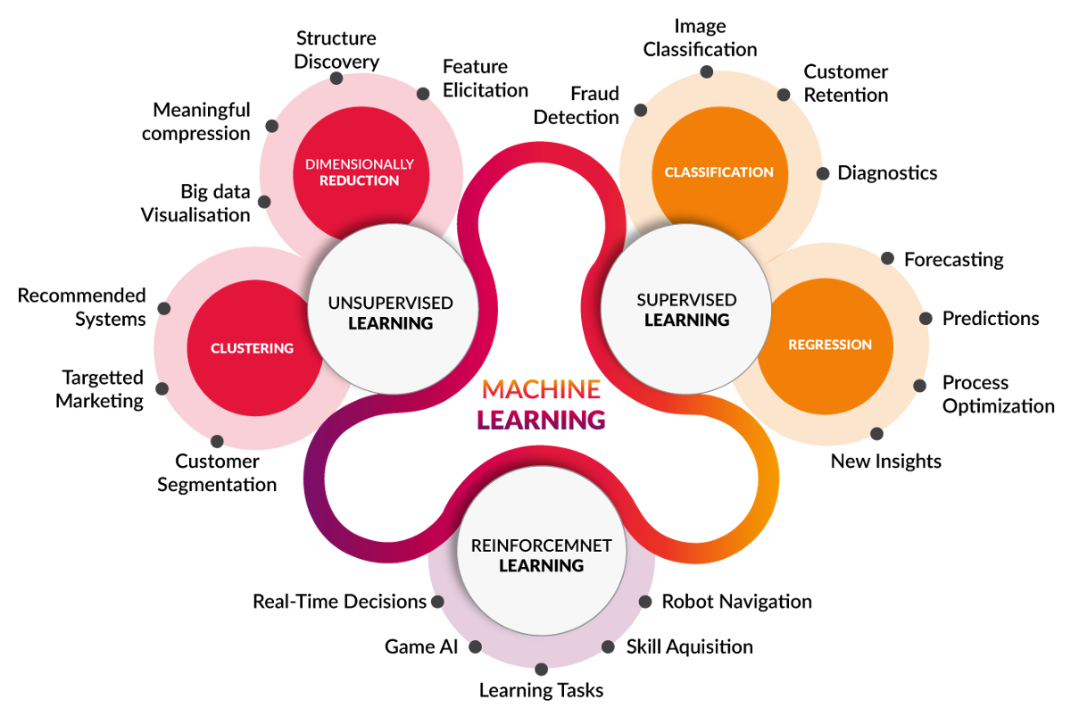

Slide 12
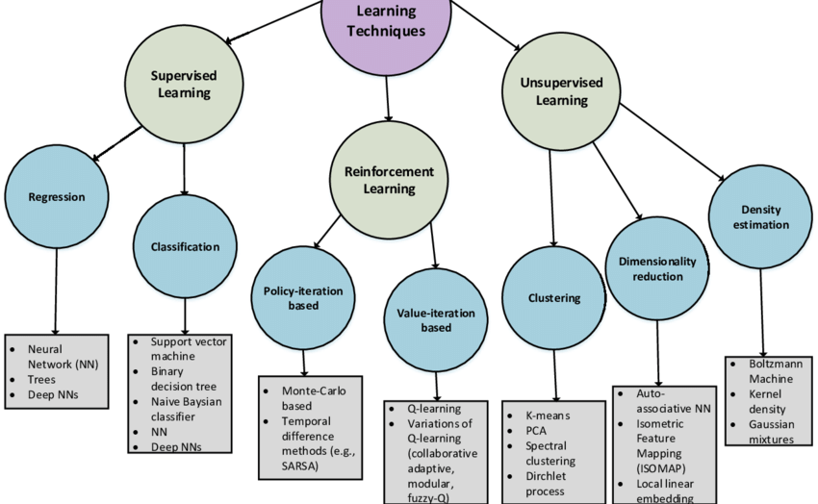

Slide 13
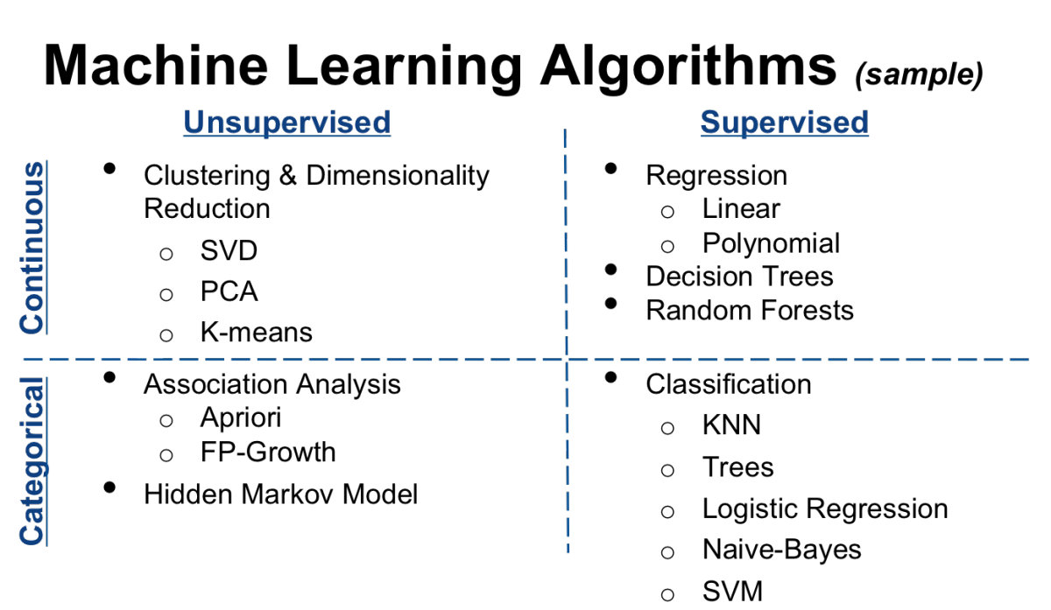

Slide 14
1. Supervised learning
empirical learning (knowledge-free)
analytical learning (knowledge-guided)
2. Unsupervised learning
3. Semi-Supervised
3. Reinforcement learning
Performance evaluation
Computational learning theory

Slide 15
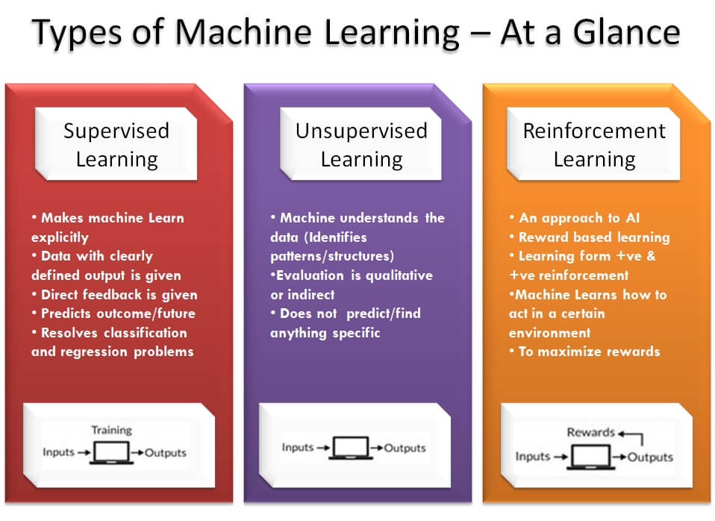

Slide 16
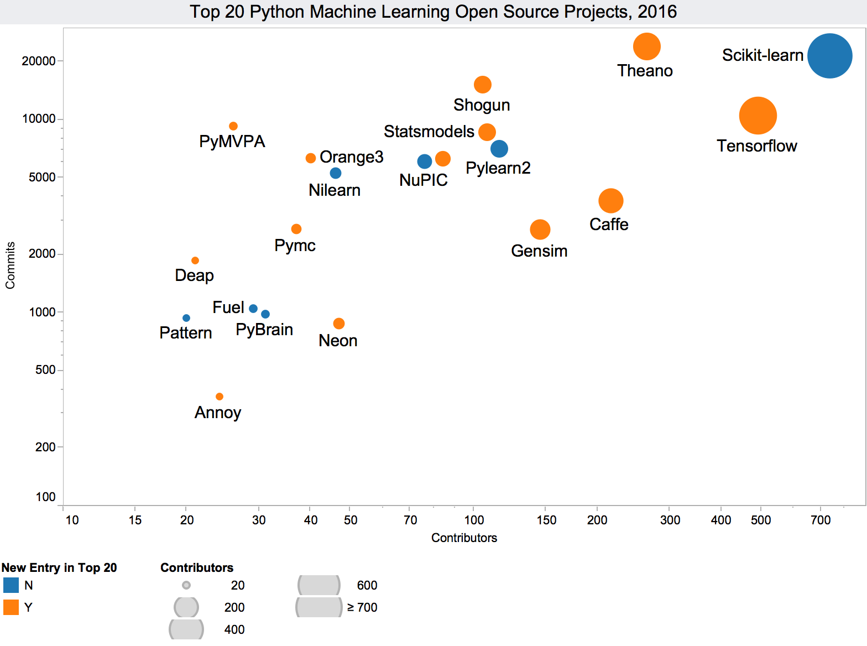


Slide 17


Slide 18
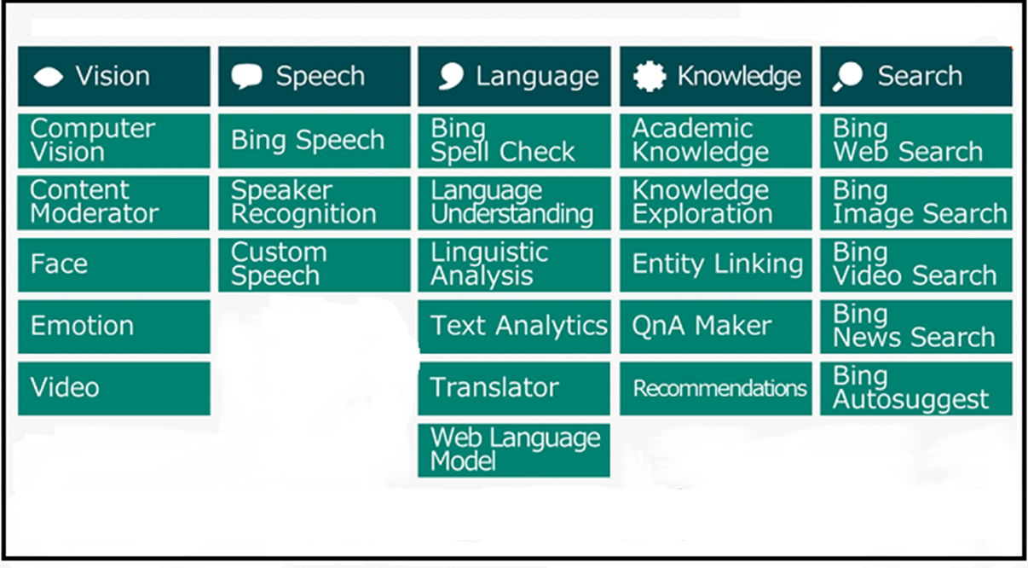

Slide 19
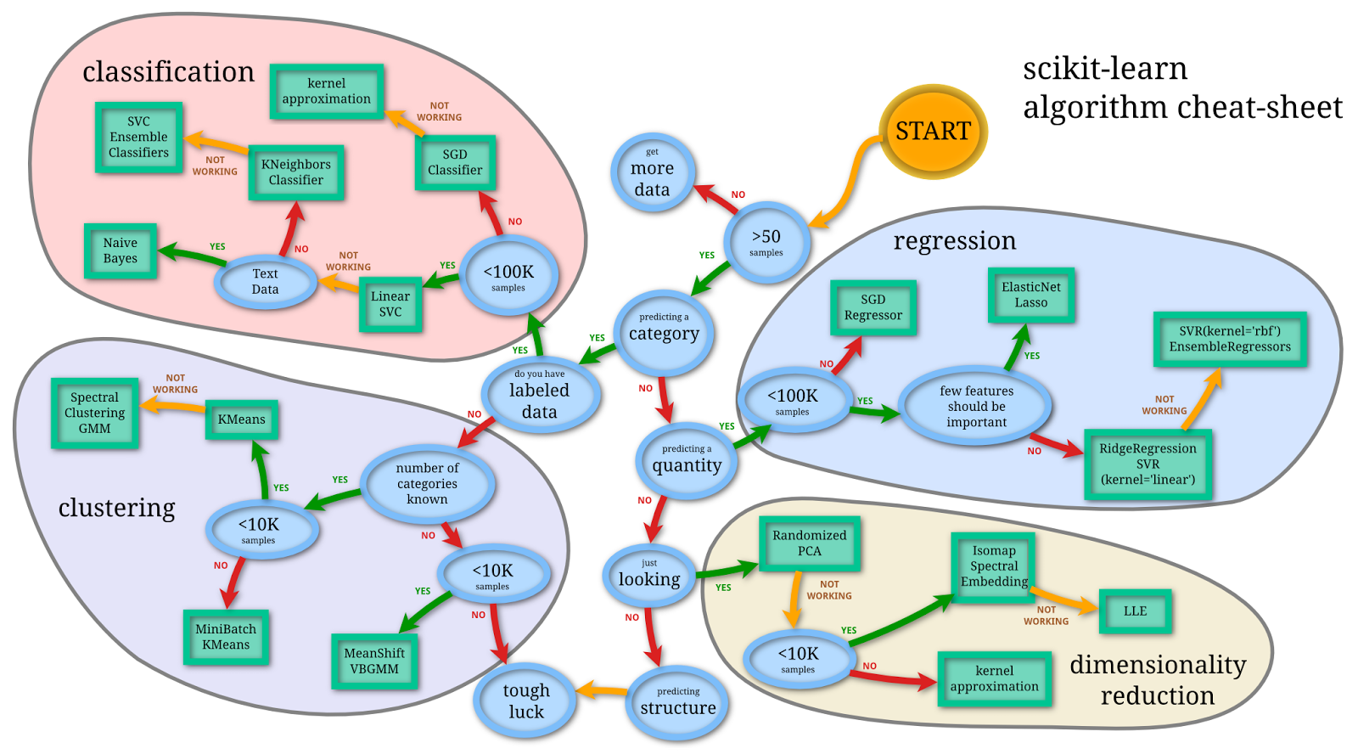

Slide 20
